Slide 1
USEMP: User Empowerment for Enhanced Online Presence Management
Contact: Adrian Popescu
CEA Tech, Franch
10/02/2014
Grant agreement no. 611596
Project duration: 10/2013 – 09/2016

Slide 2
What is USEMP?
3 years STREP project
http://www.usemp-project.eu
Consortium: CEA LIST (France); Iminds (Belgium); CERTH, Velti (Greece); Radboud University (The Netherlands); Luleå University of Technology (Sweden); HW Communications (United Kingdom)
EC Funding: 2.27 M€

Slide 3
Context and Challenges
A large majority of Europeans engage with Online Social Networks (OSNs)
74% of users consider that they do not have sufficient control
70% are concerned with the way such data are handled by OSNs
Upcoming EU General Data Protection Regulation – harmonisation of EU’s legal framework and improvement of users’ control over their shared data
Asymmetry between data processing and control means available to OSNs and those afforded by citizens
Personal data sharing is a complex and pervasive process that is still not well understood
Work in different relevant fields is most often performed in isolation

Slide 4
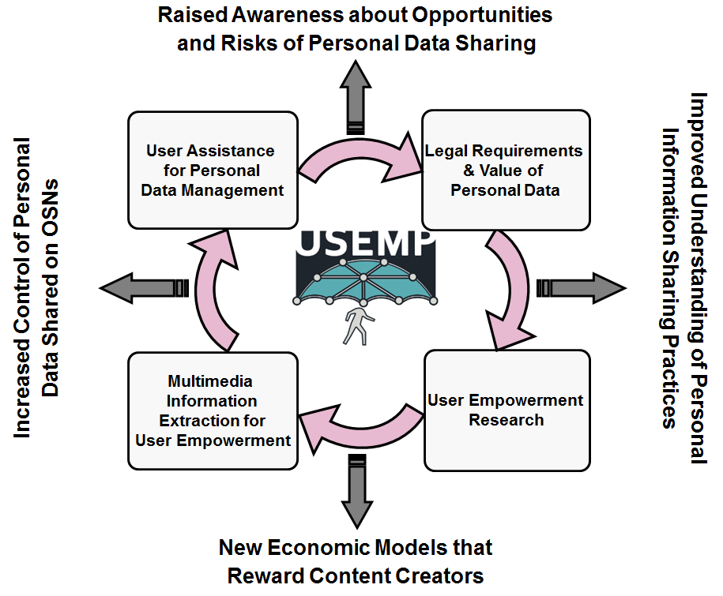
Approach in a nutshell

Slide 5
Competency matrix
Partner\domain | Multimedia mining | User assistance tools | User research | Living labs studies | Ethics & legal aspects | Integration
CEA LIST, France
CERTH, Greece
iMinds, Belgium
LTU-CDT, Sweden
Radboud U., The Netherlands
Velti, Greece
HWComms, United Kingdom
Research
Industry
Main contributor
Significant contribution

Slide 6
Objectives
Analyse the existing and proposed legal framework of privacy and data protection with regard to Online Social Networks (OSNs)
Advance the understanding of personal data handling through in-depth qualitative and quantitative user research
Create multimedia information mining tools adapted to personal information management
Build semi-automatic awareness tools to assist the users in their interaction with personal data
Contribute to the current debates related to the way personal data should be monetised
Propose an innovative living labs approach, adapted for personal data handling in OSNs

Slide 7
Expected Achievements
Enforcement of the upcoming EU General Data Protection Regulation through personal data management tools
Reduction of the asymmetry concerning data control between social networks and citizens
Raising citizens’ awareness with respect to the advantages and risks of sharing personal information
Prototyping of semi-automatic PFA tools driven by social sciences research and multimedia information extraction
Development of multidisciplinary user research on personal data within the FIRE infrastructure
Reinforcement of the position of EU academic and industrial actors in a key area of the Internet

Slide 8
Project Structure
WP1: Management
WP2: Requirements and Use Case Analysis
WP3: Legal Req. and the Value of Personal Data
WP4: User Empowerment Research and Specif.
WP5: Multimedia Information Extraction for User Empowerment
WP6: User Assistance for Shared Personal Data Management
WP7: System Design and Integration
WP8: Pilot Studies and Evaluation
WP9: Dissemination and Exploitation

Slide 9
Use Case 1: OSN Presence Control Tool
Objective: raising awareness about data shared online and improving user’s control of them
(a) Real-time OSN presence management
Development of semi-automatic privacy preservation tools
Joint analysis of volunteered, observed and inferred data
(b) Long-term OSN presence management
Visualisation tool which summarizes the privacy status
Controls for quick personal data visibility change

Slide 10
Use case 2: Economic Value Awareness Tool
Objective: assist the user in understanding the economic value of data shared online
(a) Awareness of the Economic Value of Personal Information
Modelling of the personal data monetisation process performed by OSNs
Contribution to the transparency of OSN business models
(b) Personal Content Licensing
Simulation of a framework for licensing personal information
Avoidance of commodification through an adapted rewards mechanism

Slide 11
Use Case Analysis (iMinds)
Multidisciplinary project: alignment of perspectives of consortium partners
Analysis started during the kick-off meeting
Tech cards: clear description of technologies available and/or to develop
Scenarios proposals available
2 days meeting in Brussels (13/02 and 14/02 2014) to refine use cases

Slide 12
Multimedia Mining (CEA)
Semantic text representation
“Classical” Explicit Semantic Analysis (ESA) implemented
Improved version currently implemented
Visual content mining
Object recognition: very promising results obtained with neural network features
MAP 0.772 on PascalVOC 2014 dataset (best known result: 0.778)
Object detection: work started for GPU implementation of the process

Slide 13
Privacy and Feedback Awareness Tools (CERTH)
Eight key privacy dimensions identified
Demographics, Psychological Traits, Sexual Profile, Political Attitudes, Religious Beliefs, Health Factors and Condition, Location and Consumer Profile
Consequent list of tools related to USEMP objectives
https://www.privacyfix.com
http://www.privacy-awareness-app.org
http://www.reclaimprivacy.org

Slide 14
Acknowledgements
This project has received funding from the European Union’s Seventh Framework Programme for research, technological development and demonstration under grant agreement no. 611596

Slide 15
Thank You

